Slide 1
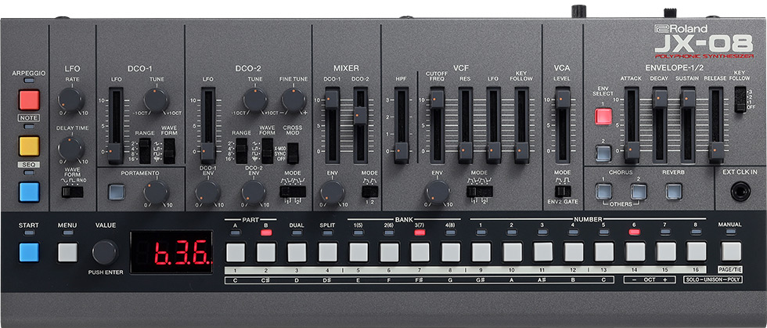
Roland JX-08 Analog Synthesizer Signal Block Diagram
as of 2022/2/11 Ver0.84
Author: rezeik8
PART A/B
[PART]
A
Module x6
[Module]
B
A
B
C
D
E
F
Portamento
DCO1
MIX
VCF
VCA
Stereo
Chorus
Reverb
LINE /
HP out
DCO1
TUNE
HPF
LPF
DCO2
＋
＋
ENV
Cross
mod
ENV
Keyboard
/ MIDI
Note in
Arpeggiator
/Sequencer
DCO2
VCA-
MODE
SW
TUNE
＋
TUNE
FINE
Gate
ENV2
＋
ENV
ENV
LFO
LFO
Rate
Delay
DCO-
MODE
SW
MIX-
MODE
SW
VCF-
MODE
SW
ENV1
Legend
ENV1
ENV2
ENV1
ENV2
ENV1
ENV2
Audio path
ADSR
Control path
ENV2
ADSR

